Slide 1
RESULT ORIENTED MILLING EFFORTS

Slide 2
OBJECTIVE OF MILLING
Milling is not only to crush the sugar cane, it is the art of gaining maximum possible extraction of sugar cane avoiding the extraction of non sugars, allowing minimum sucrose and moisture in final bagasse by utilizing the optimum energy.

Slide 3
FACTORS INFLUENCING MILLING OPERATION
CANE PREPARATION
ROLLER GROOVING
MILL SPEED
MILL SETTING
DONNELY CHUTE SETTING
THE PRESENTATION MAINLY DISCUSS:
HYDRAULIC LOAD
IMBIBITION

Slide 4
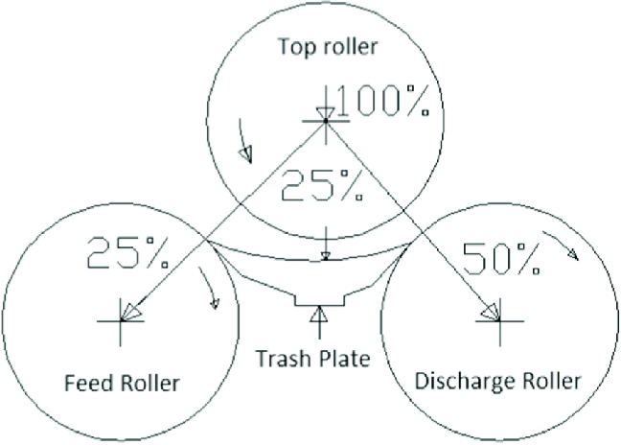
HYDRAULIC LOAD DISTRIBUTION IN THE MILL

Slide 5
DYNAMIC COMPRESSION OF FIBER
ᵩ
β
FREE JUICE EXTRACTED
NEUTRAL PLANE
STATIONARY POOL FREE JUICE
AUXIAL PLANE

Slide 6
ROLLER SIZE 42” X 84”
HYDRAULIC PRESSURE
186 kg / cm²
HYDRAULIC PRESSURE 172 kg / cm²
54 Kg/Cm²
59 Kg/Cm²
JOURNAL SIZE 530 X 670
FORCE EXERTED BY ROLLER ON BAGASSE
427 TONS
FORCE EXERTED BY ROLLER ON BAGASSE
459 TONS
LOOSE BAGASSE LAYER 470 MM AND MILL FEED OPENING 65 MM AT REST.

Slide 8
FORMAL IMBIBITION PRACTICE
Bagasse retains 45% juice not extractable by mechanical means, since this juice cannot be extracted, the efforts are made to replace it with water or low brix juice, this process is termed as imbibition.
The extraction depends on the ratio of applied water to the fiber, not to the quantity of applied water
The formal distribution is operating in the plane longitudinal to the delivery rollers nip of the rollers since part of the bagasse adheres to the top roller this allows the water to reach in the mid layer of the bagasse.

Slide 10
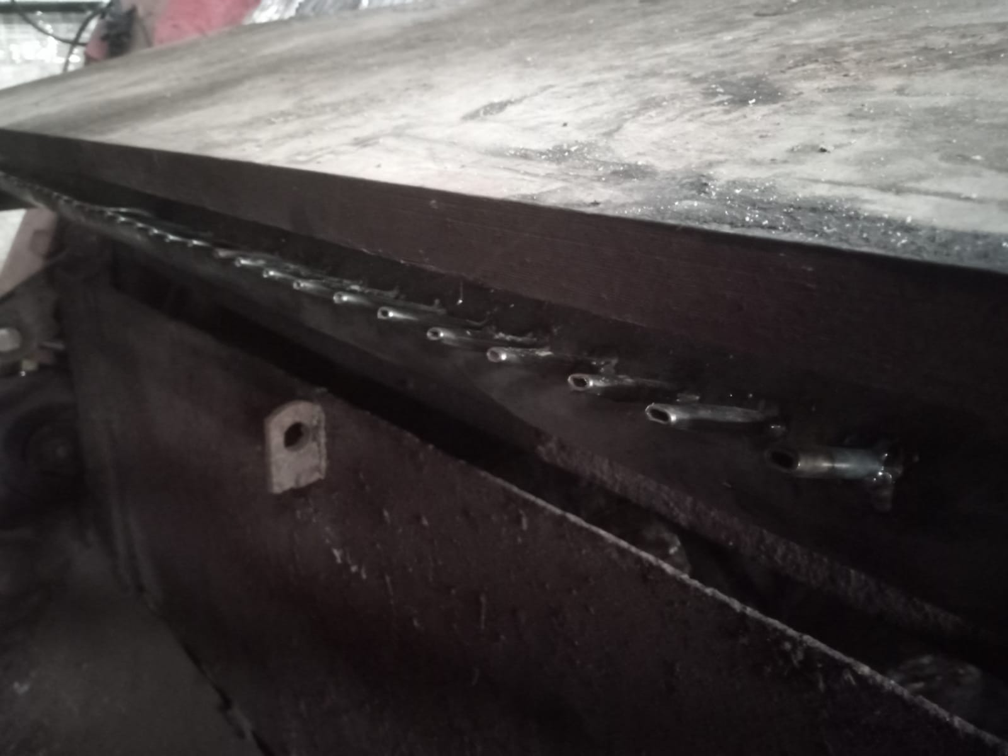
NOZZLE PITCH = 50 mm
NOZZLE DIA = 6 mm
NOZZLE ANGLE = 27ᵒ

Slide 11
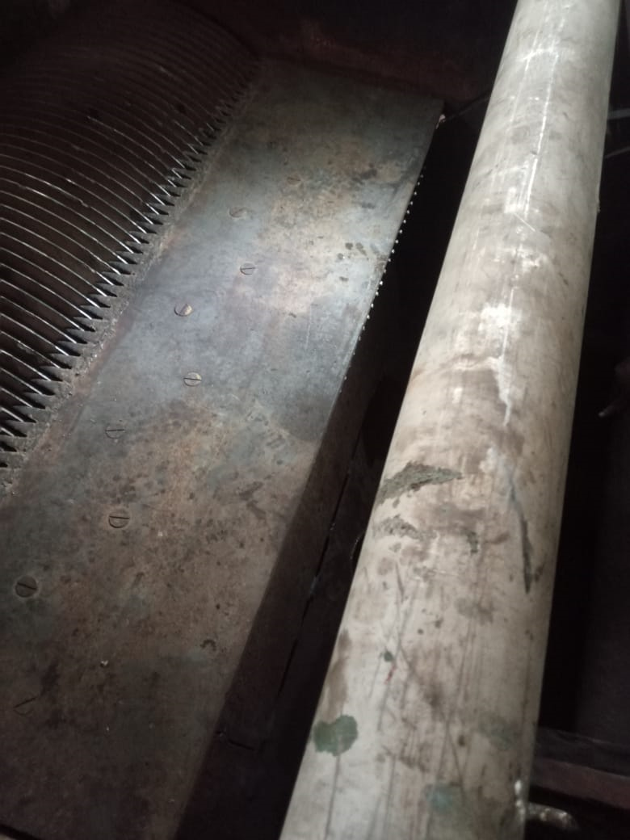

Slide 13
SATURATION OF FIBER
W/F Ratio = 3.186
BAGASSE
MOISTURE = 54.00 %
FIBER = 43.00 %
BRIX = 3.00 %
Water/Fiber (W/F) Ratio = 1.256
BAGASSE
MOISTURE = 80.59 %
FIBER = 18.14 %
BRIX = 1.27 %
Water/Fiber (W/F) Ratio = 4.442
W/F = 7.0
55.465 % of Layer
1.256 + 3.186 = 4.442 W/F

Slide 14
EFFICIENT IMBIBITION PRACTICES
Additional point of imbibition water before the last mill is provided under the discharge scrapper, striking the bagasse bottom layer
One additional point is provided at the apex of bagasse carpet splits into the inter carrier.
Imbibition water distribution
On Trash plate nozzles = 50 Tons
Under the trash = 30 Tons
Bagasse surface = 60 Tons
Split bagasse point = 20 Tons

Slide 15
MAXIMUM ALLOWED IMBIBITION ON FIBRE % CANE
Cane crushing in kg/h | 458 | @ 11000 TCD
Water temperature in Cᵒ | 60
Fiber % cane | 14.27
Peripheral speed of mill roller | 15.7 | Roller diameter 1060 mm
Maximum imbibition of fiber % cane | 364 | 320

Slide 17
CONSEQUENCE OF ALTERING MILLING STRATEGY
SEASON | 2021-22 | 2022-23 | REMARKS
Average cane crushing in TCD | 7625 | 8391.5 | + 10 %
Mill extraction | 96.30 | 96.34 | + 0.04
Bagasse pol % | 1.53 | 1.44 | - 5.88 %
Bagasse moisture % | 51.7 | 51.63 | - 0.14 %
Imbibition % | 46.49 | 45.46 | - 2.2 %

Slide 18
QUESTIONS CORRELATED TO THE PRESENTATION

